Slide 1
Digital Portfolio
STUDENT NAME: SHREE HARINI K
REGISTER NO AND NMID: asbruaz2428c0517
DEPARTMENT: II - B.Sc AIML
COLLEGE: KPR College Of Arts Science And Research / Bharathiar university

Slide 2
PROJECT TITLE
Volunteer & Social Work Portfolio using HTML,CSS and JAVASCRIPT.

Slide 3


AGENDA
Problem Statement
Project Overview
End Users
Tools and Technologies
Portfolio design and Layout
Features and Functionality
Results and Screenshots
Conclusion
Github Link
3/21/2024 Annual Review

Slide 4

PROBLEM STATEMENT
Many individuals actively participate in volunteer and social work, but their efforts often go unnoticed due to the lack of proper documentation and representation. Without a structured portfolio, it becomes challenging to showcase contributions, skills, and impact in a professional manner. This creates difficulties when applying for scholarships, jobs, or community programs where social involvement is valued. A well-designed volunteer and social work portfolio is needed to highlight achievements, track experiences, and demonstrate personal growth. It serves as a bridge between community service and future opportunities.

Slide 5

PROJECT OVERVIEW
This project presents a well-structured Volunteer & Social Work Portfolio that reflects my personal journey of service and community engagement. It provides a clear record of my experiences, achievements, and impact in the field of social work.
The portfolio includes:
About Me – Introduction and motivation behind my volunteering efforts.
Projects – Highlights of key initiatives, contributions, and outcomes.
Contact – Easy access to connect for collaborations or opportunities.
The portfolio serves as both a showcase of my dedication to social causes and a professional tool to represent my growth and commitment.

Slide 6

WHO ARE THE END USERS?
This portfolio is useful for individuals and organizations to document, showcase, and recognize volunteer contributions. It helps bridge the gap between volunteers and communities while supporting personal and professional growth.
.Job Seekers & Professionals – To highlight social engagement and soft skills.
NGOs & Non-Profit Organizations – For collaboration and volunteer recruitment.
Academic Institutions – To track and encourage student participation.
Community Leaders & Social Groups – To recognize and support impactful work.
Students – For scholarships, internships, and higher studies.
Event/Project Coordinators – To connect with active volunteers.

Slide 7

TOOLS AND TECHNIQUES
HTML – Provides the structure of the portfolio with sections like About Me, Projects, and Contact.
CSS – Adds styling through layouts, colors, fonts, responsive design, and simple animations.
JavaScript – Enhances interactivity with features like form validation, smooth navigation, and dynamic effects.

Slide 8
POTFOLIO DESIGN AND LAYOUT
Header:
Introduces your mission: Dedicated to Volunteerism & Social Impact.
Gives visitors an immediate idea of your purpose and focus.
About:
Briefly explains your passion for giving back to the community.
Highlights key areas of involvement: teaching, environmental initiatives, and social outreach.
Sets the context for the experiences showcased later.
Experience:
NGO Teaching Program – Volunteered to teach underprivileged children basic skills, emphasizing education and empowerment.
Tree Plantation Drive – Participated in planting and maintaining trees, promoting environmental awareness and sustainability.
Fundraising Campaign – Organized campaigns to raise funds for community and disaster relief initiatives.
8

Slide 9
Contact
Provides email and social media links for networking and collaboration.
Encourages engagement with people or organizations interested in volunteering or partnerships.
Footer
Serves as a professional closure with copyright information.
Reinforces ownership and branding of your portfolio.

Slide 10
FEATURES AND FUNCTIONALITY
Navigation Bar with Smooth Scrolling:
> The fixed top navigation allows users to jump to different sections (Home, About, Experience, Contact).
> Smooth scrolling is implemented using JavaScript, creating a polished and modern browsing experience without sudden jumps.
Project / Experience Showcase:
> Volunteer experiences are presented in card layouts, each highlighting a specific project or initiative.
> Cards contain titles and short descriptions to clearly communicate your contributions.
> The design is visually structured, making it easy for visitors to scan through your achievements.
Interactive Elements:
> Hover effects on cards add subtle animations, like lifting or shadow changes, making the portfolio engaging.
> Text highlights and color changes on hover provide visual feedback to users.
> Overall, animations enhance user experience without being distracting.

Slide 11
Contact Section:
> Provides email and social media links for networking and collaboration.
> Can be extended with a contact form including input validation to ensure correct submissions.
> Encourages interaction with potential collaborators, NGOs, or employers.
Responsive Design
> The layout adapts to all device sizes (desktops, tablets, mobile phones).
> CSS Flexbox and Grid are used to make sections and cards flexible and maintain spacing.
> Ensures a consistent, user-friendly experience across all screen sizes.
Clean & Modern UI
> Minimalistic color scheme (green, gold, white, gray) aligns with a professional volunteering theme.
> Full-screen hero section creates a strong first impression.
> Typography (Google Fonts – Poppins) enhances readability and aesthetics.

Slide 12
Accessibility & Usability Considerations:
> Sections are structured with clear headings and IDs for navigation.
> Contrast between text and background ensures readability.
> Smooth scrolling and hover effects improve overall user experience.

Slide 13
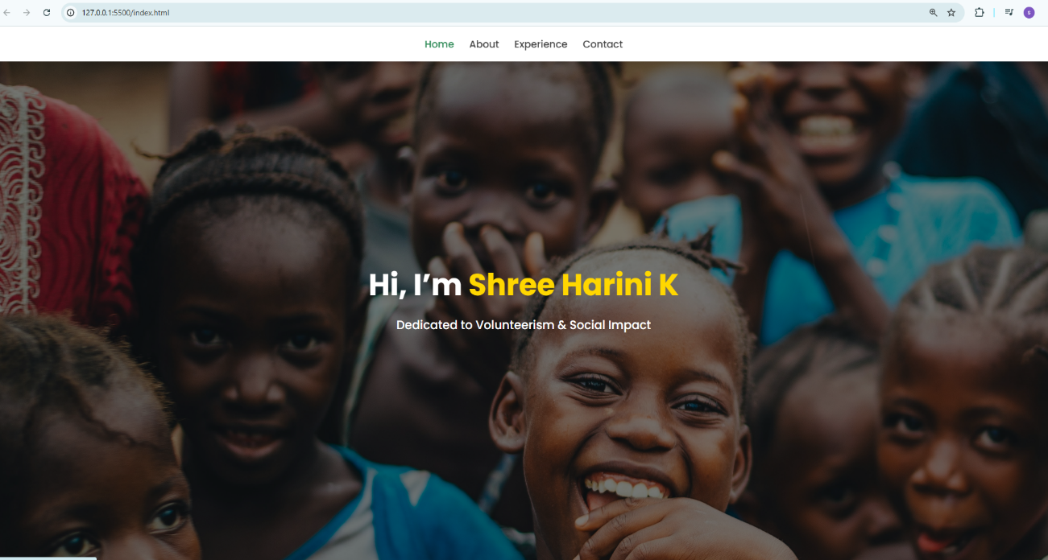
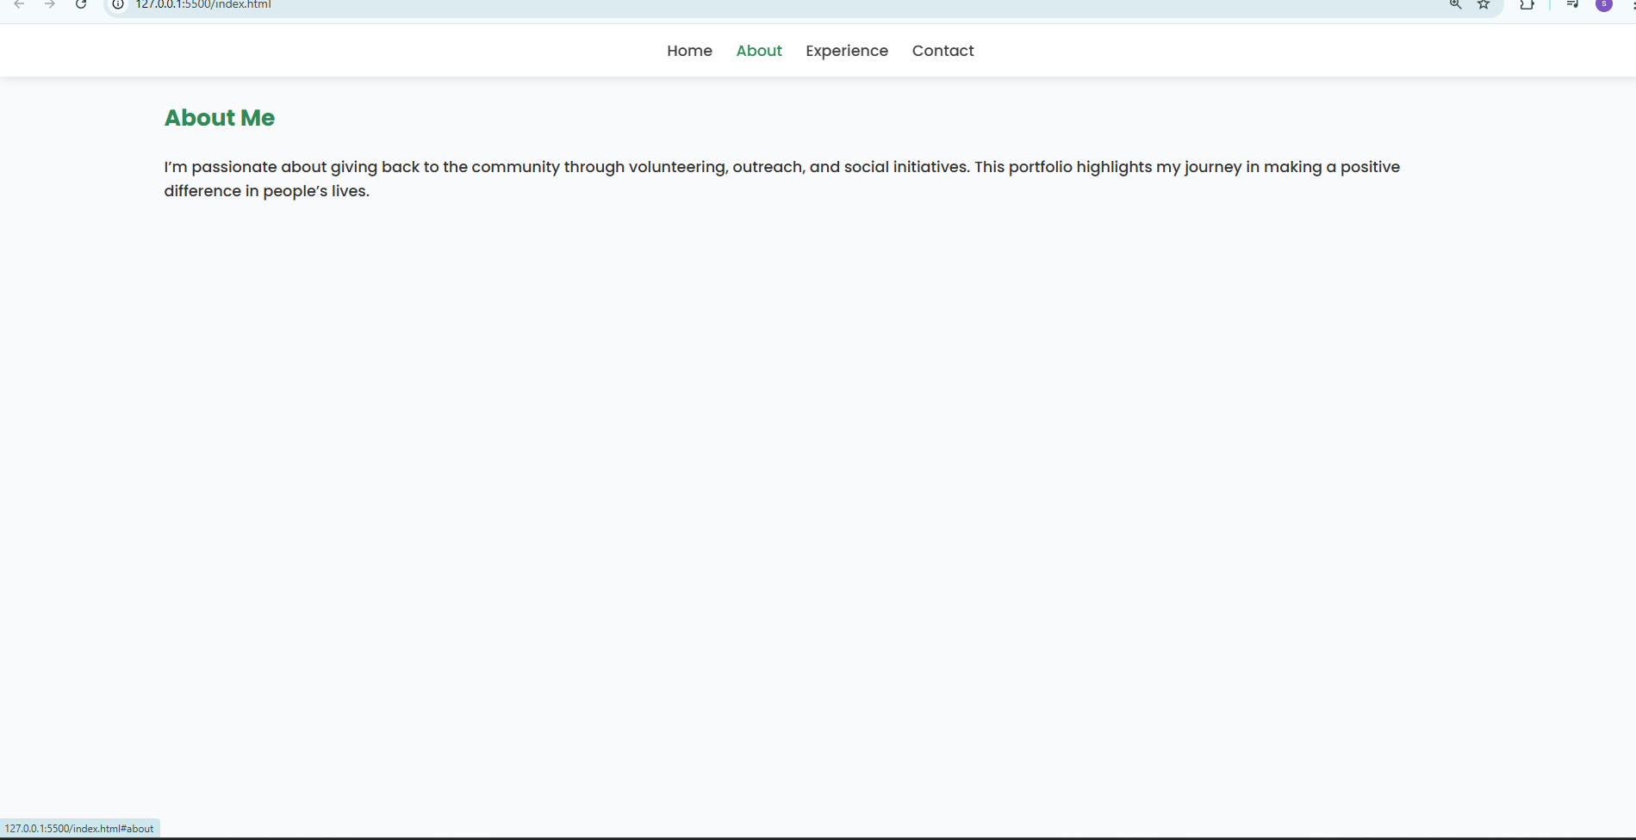
RESULTS AND SCREENSHOTS
3/21/2024 Annual Review
13

Slide 14
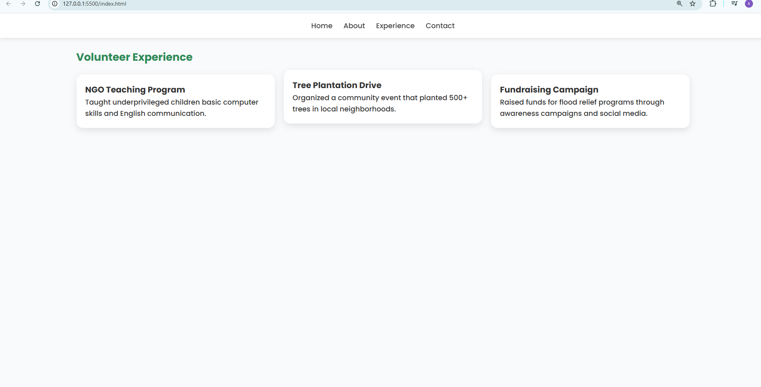
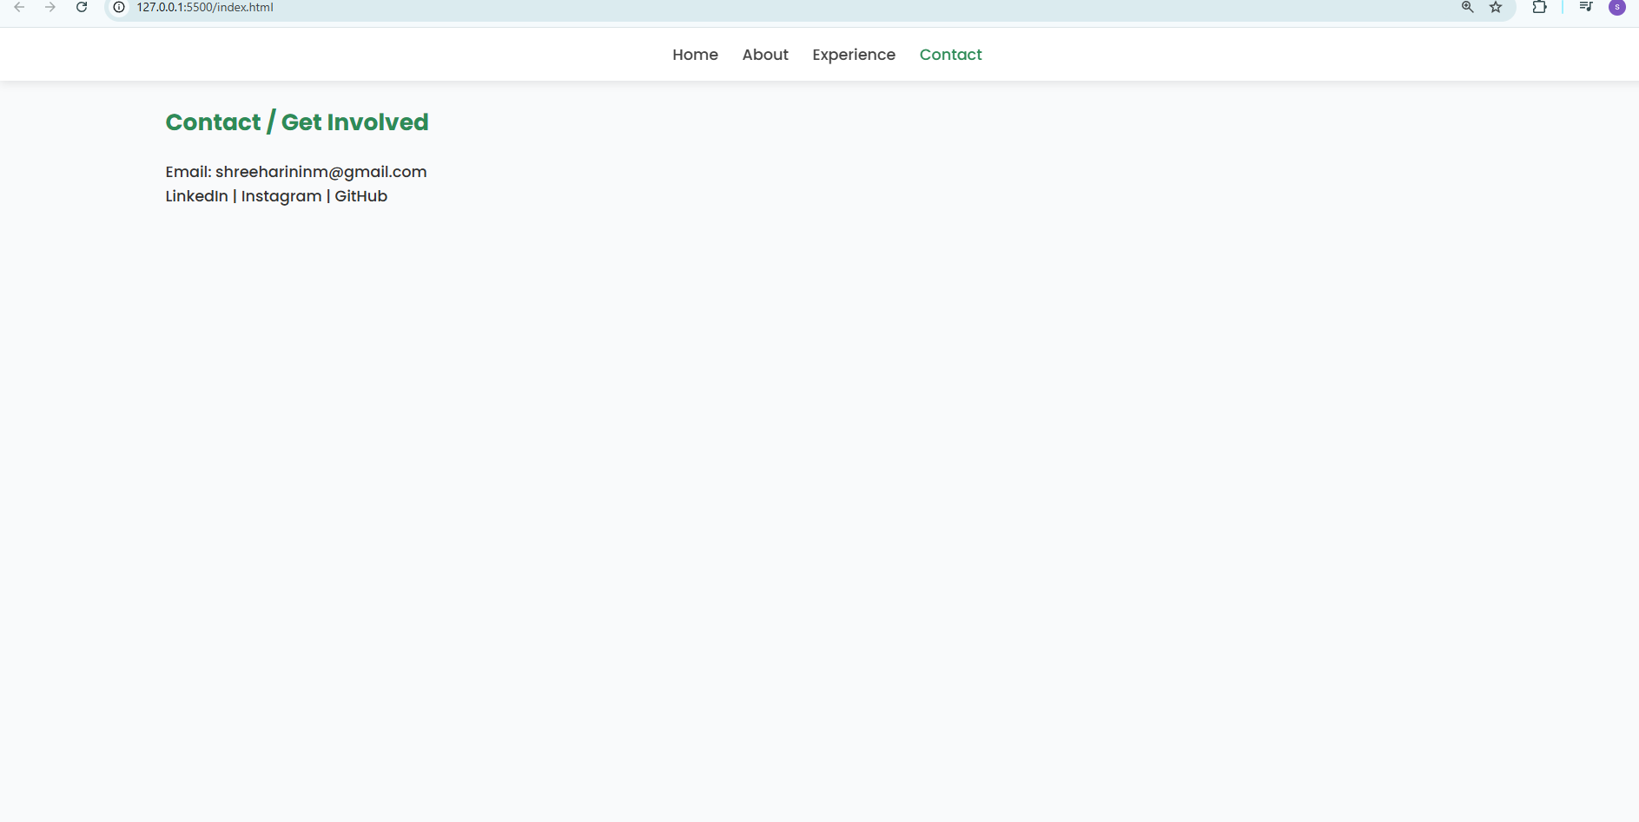

Slide 15
CONCLUSION
This Volunteer & Social Work Portfolio effectively highlights the key aspects of your volunteer journey, including teaching, environmental initiatives, and community outreach. With a clean, modern, and responsive design, interactive elements such as hover effects and smooth scrolling, and a clear navigation structure, the portfolio not only showcases your contributions but also provides an engaging user experience.
By presenting your experiences in an organized and visually appealing way, this portfolio can inspire others to participate in social initiatives and serve as a resource for NGOs, community organizers, and fellow volunteers to connect, collaborate, and make a positive impact. It demonstrates the value of volunteering and encourages a culture of social responsibility.
In summary, this project is a comprehensive representation of your dedication to making a difference, combining professional presentation, usability, and social impact, making it both informative and inspiring for all who visit.
15

